Slide 1
Movie Recommendation
Team 7
Xiao Hu
Yumeng Chen

Slide 2
Goals of Project
For this system, there are two main goals: Movie Recommendation and Movie Searching.
For us, we want to learn more about the specific algorithm and the using of scala.

Slide 3
Use Cases
●User rates movies and will receive more accurate result of movie recommendation list which he/she might like.
●User inputs criteria for movie with(cast,etc) and is shown list of matching properties(default by rating descending order)

Slide 4
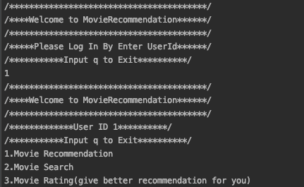
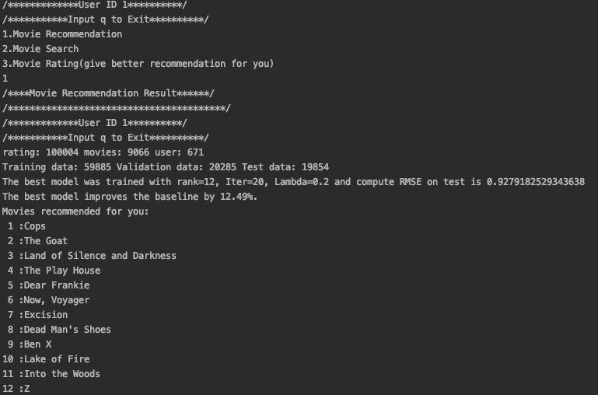
Use Cases
User can easy follow the instruction on the screen, which including entering user ID, chose the service, and entering the rating data.etc

Slide 5
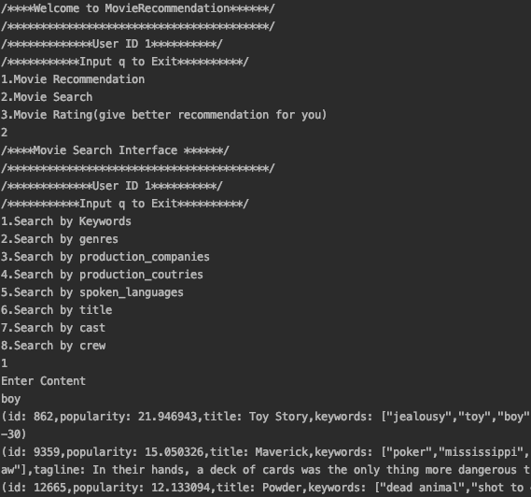
Use Cases

Slide 6
Methodology
Extract the movie data and rating data from kaggle dataset website (https://www.kaggle.com/rounakbanik/the-movies-dataset#credits.csv)
Clean and break down the text of JSON format into words
Train the model
Calculating the result of Recommendation List

Slide 7
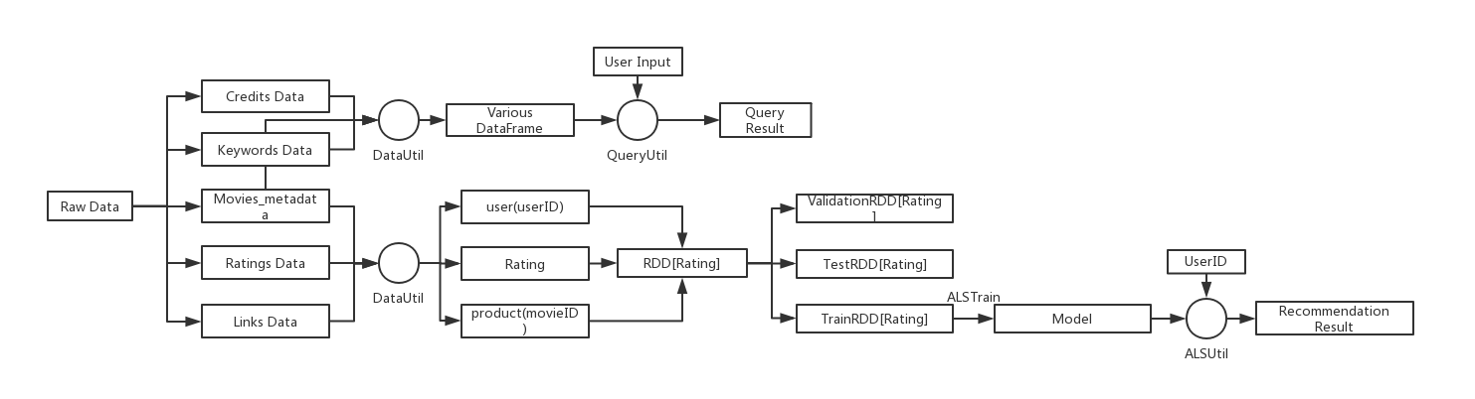
Methodology-Work Flow

Slide 8
Data Source
https://www.kaggle.com/rounakbanik/the-movies-dataset
This dataset has files containing 26 million ratings from 270,000 users for all 45,000 movies.
Ratings are on a scale of 1-5 and have been obtained from the official GroupLens website.
movie_metadata: Contains informations of the movies like title, language and genres,etc.
credits: Contains Cast and Crew information for all movies
keywords: Contains keywords for all movies
links: Contains IMDB ID and TMDB ID for all movies features in rating data
rating: Contains rating information for movies and users.

Slide 9
Program in scala
Repository
The implements of ALS
All the unit test
Extraction of data
Store the user rating data
https://github.com/DSNFZ/CSYE7200_FINAL_PROJECT

Slide 10
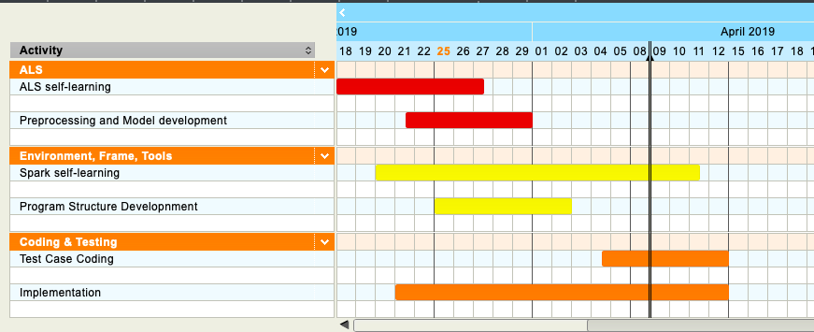
Milestone

Slide 11
Acceptance criteria
Root Mean Square Error(RMSE):
RMSE is a measure of how spread out those residual are. In other words, it is used to measure the difference between values that predicted and values that actually observed.
The smaller the Square Error(<1), the better the model.
Response time < 2 Seconds.

Slide 12
Thanks for your watching

